Slide 1
PROJECT 2 ATM MACHINE

Slide 2
Hello!
Lê Võ Diễm Hằng ITITIU18034
Huỳnh Phương Quyên ITITIU18181
Nguyễn Huỳnh Phương Thanh ITITIU18115
Nguyễn Giang Ngọc Trâm ITITIU18158
GROUP 2

Slide 3
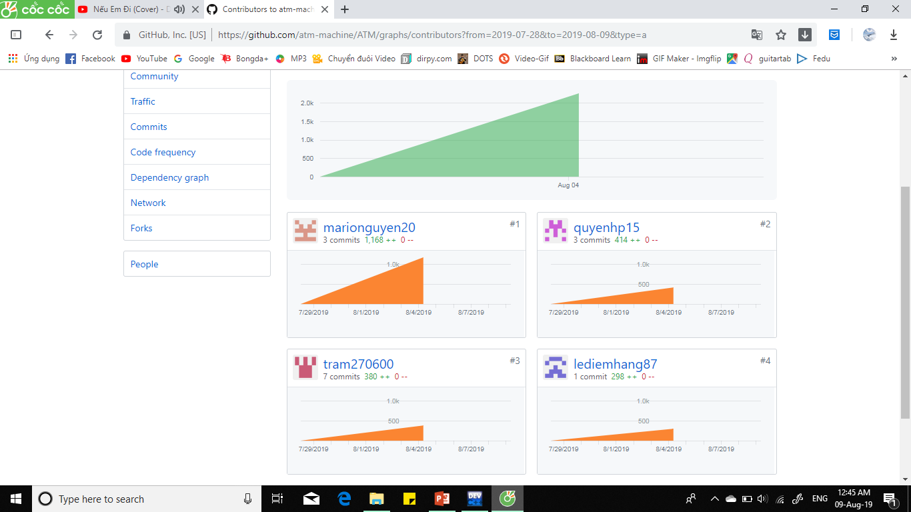
CONTRIBUTION

Slide 4
Introduction
Check information
Withdraw
ATM Machine
- Demo of the machine
programming.
- Smart interface with people.
- Supply various servies.
Change Password
Deposite
Transfer

Slide 5
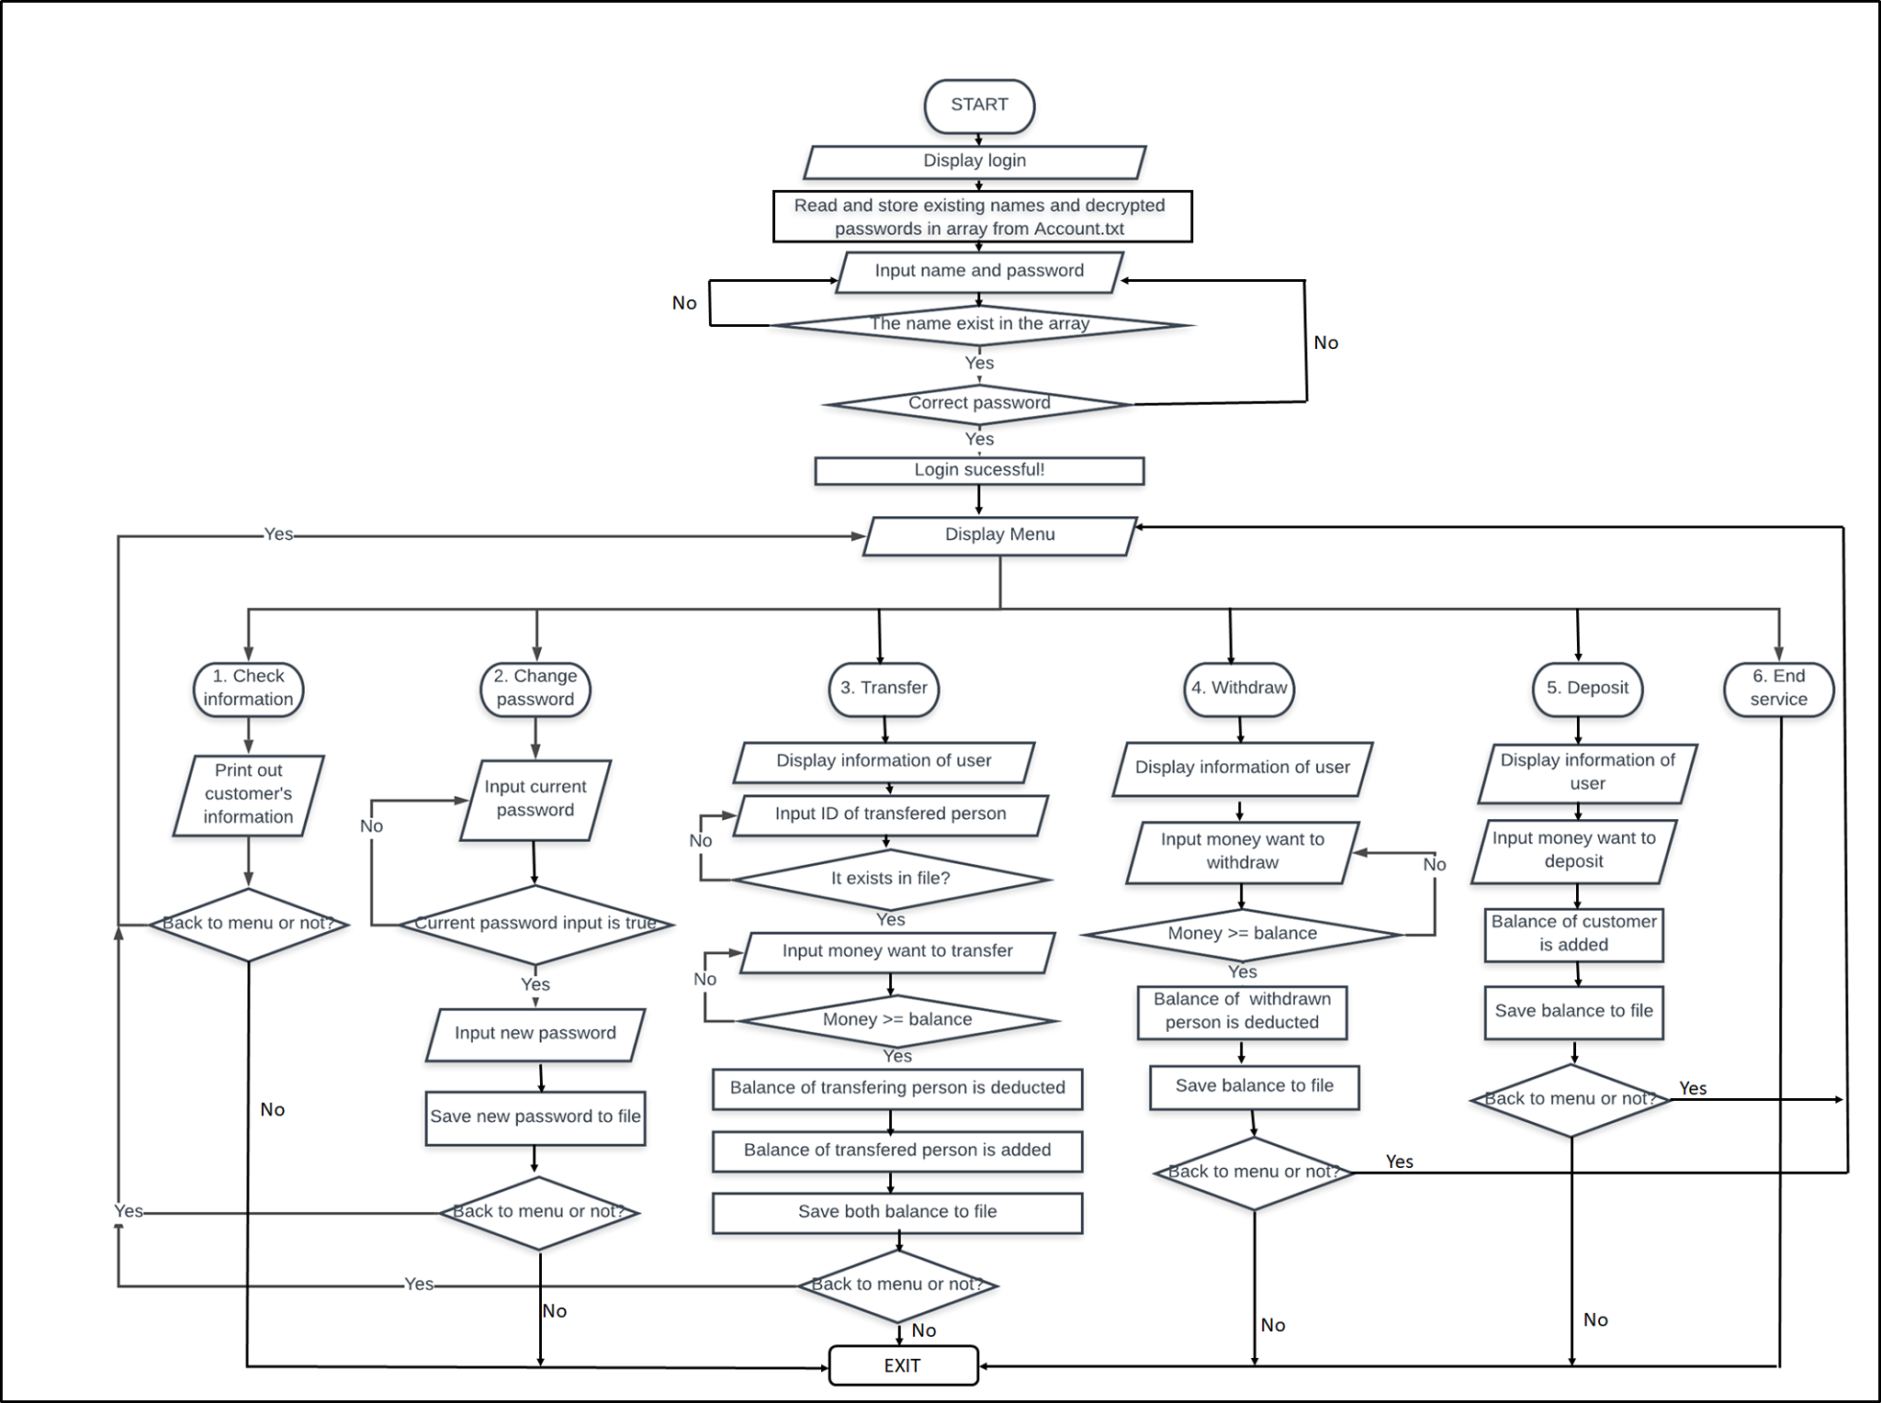
FLOW CHART

Slide 6
LOGIN SYSTEM
1
Let begin with login system

Slide 7
Flowchart
6 functions.

Slide 8
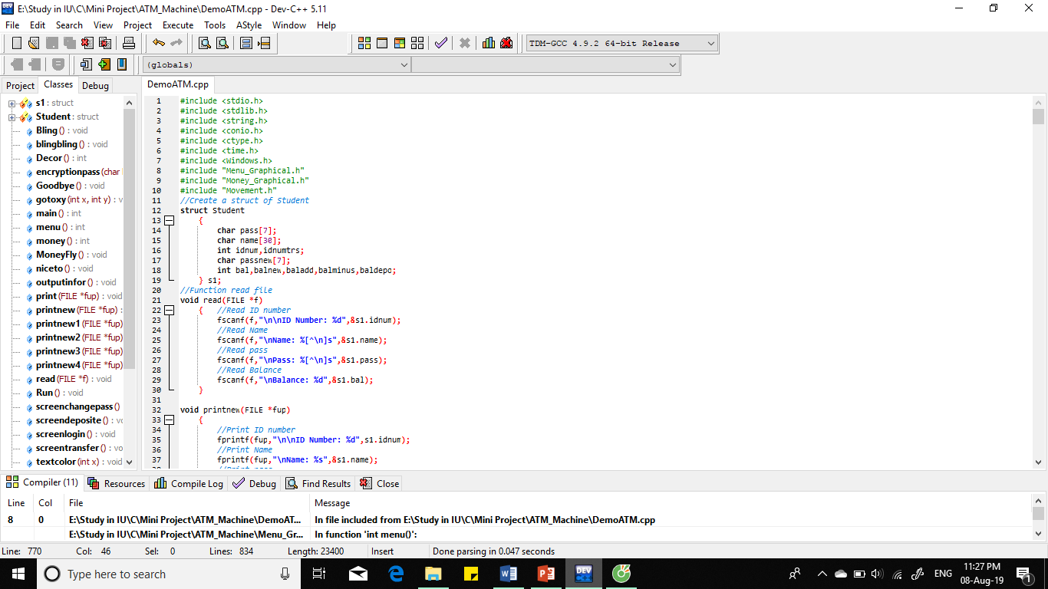
FUNCTION
Struct for user

Slide 9
FUNCTION
Struct for user
Read File

Slide 10
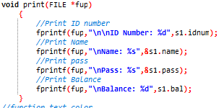
FUNCTION
Print File

Slide 11
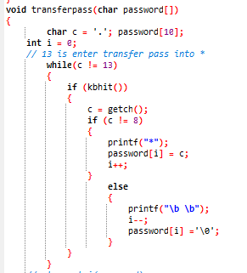
FUNCTION
Transfer pass

Slide 12
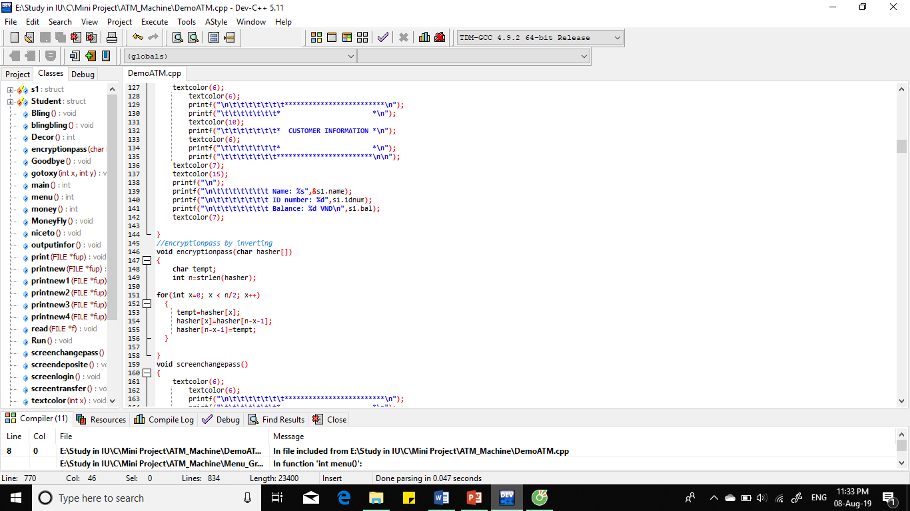
FUNCTION
Encryption

Slide 13
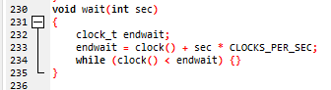
FUNCTION
Count time

Slide 14
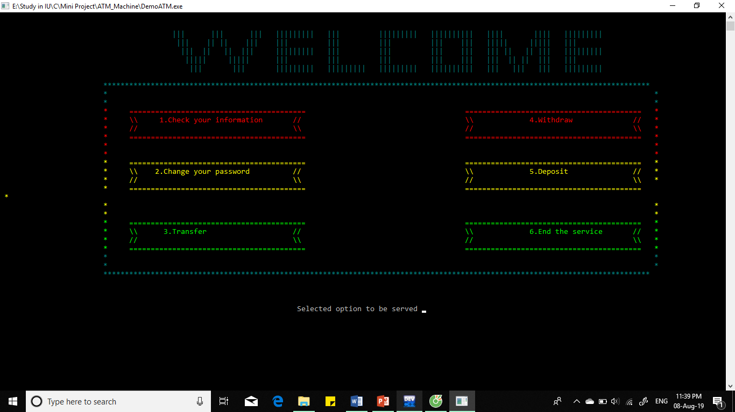
Place your screenshot here
MENU DISPLAY
Has 6 options
Use Switch loop – divided 6 cases.

Slide 15
CHECK INFORMATION
2
Let move on to check information case.

Slide 16
Flowchart
1 function.

Slide 17
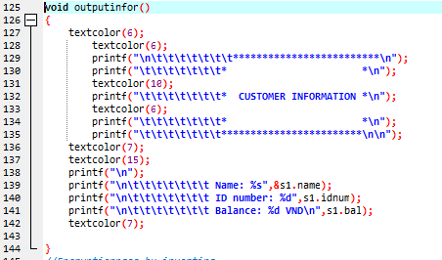
FUNCTION
Output information

Slide 18
CHANGE PASSWORD
3
Let move on to change password case.

Slide 19
Flowchart
3 functions.

Slide 20
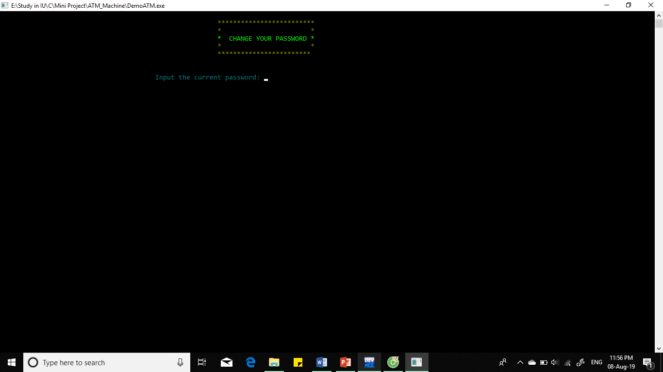
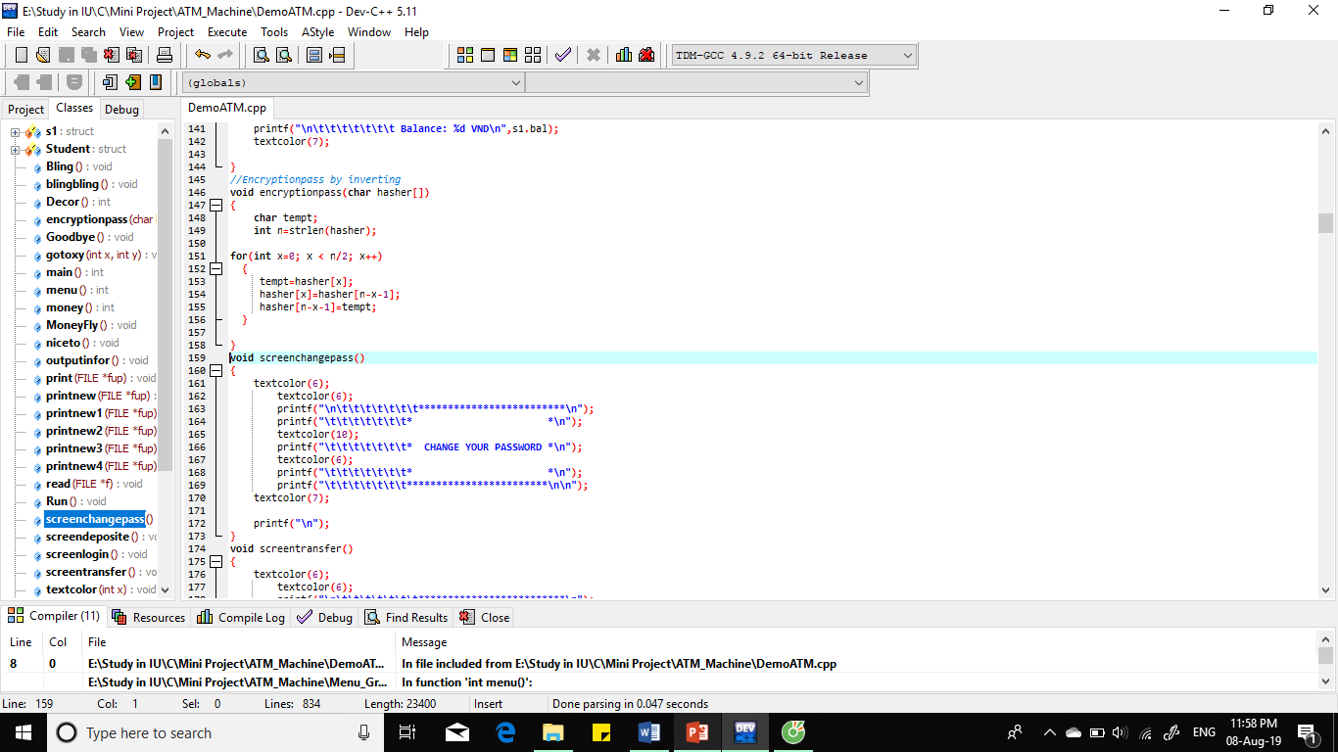
Change password screen
Place your screenshot here

Slide 21
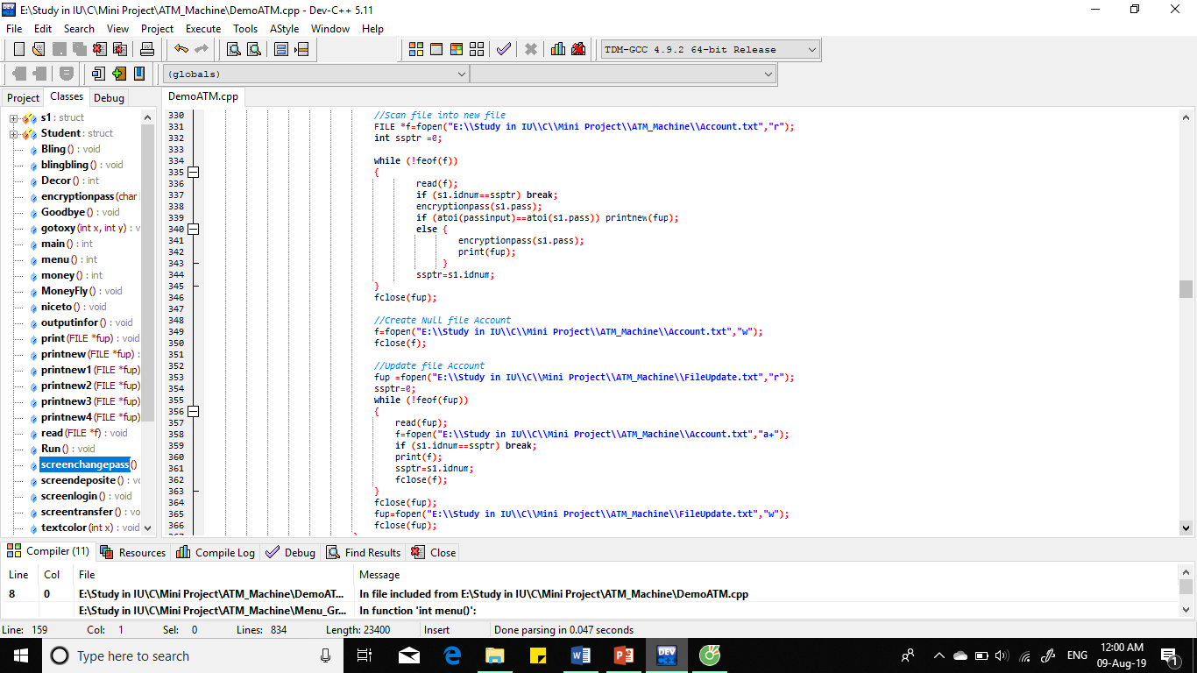
UPDATED PASSWORD

Slide 22
TRANSFER MONEY
4
Let move on to transfer money case.

Slide 23
Input ID and name of person to transfer. Check exist or not.
Input amount of money. If larger than , smaller or equal current balance.
Ask user continue to transfer to below ID or not. If continue, input next money.
Calculate the sum of transfer amount.
Upload new balance information after transfer of both remitter and recipient from Update.txt to ID.txt
Clear Update.txt
PSEUDOCODE

Slide 24
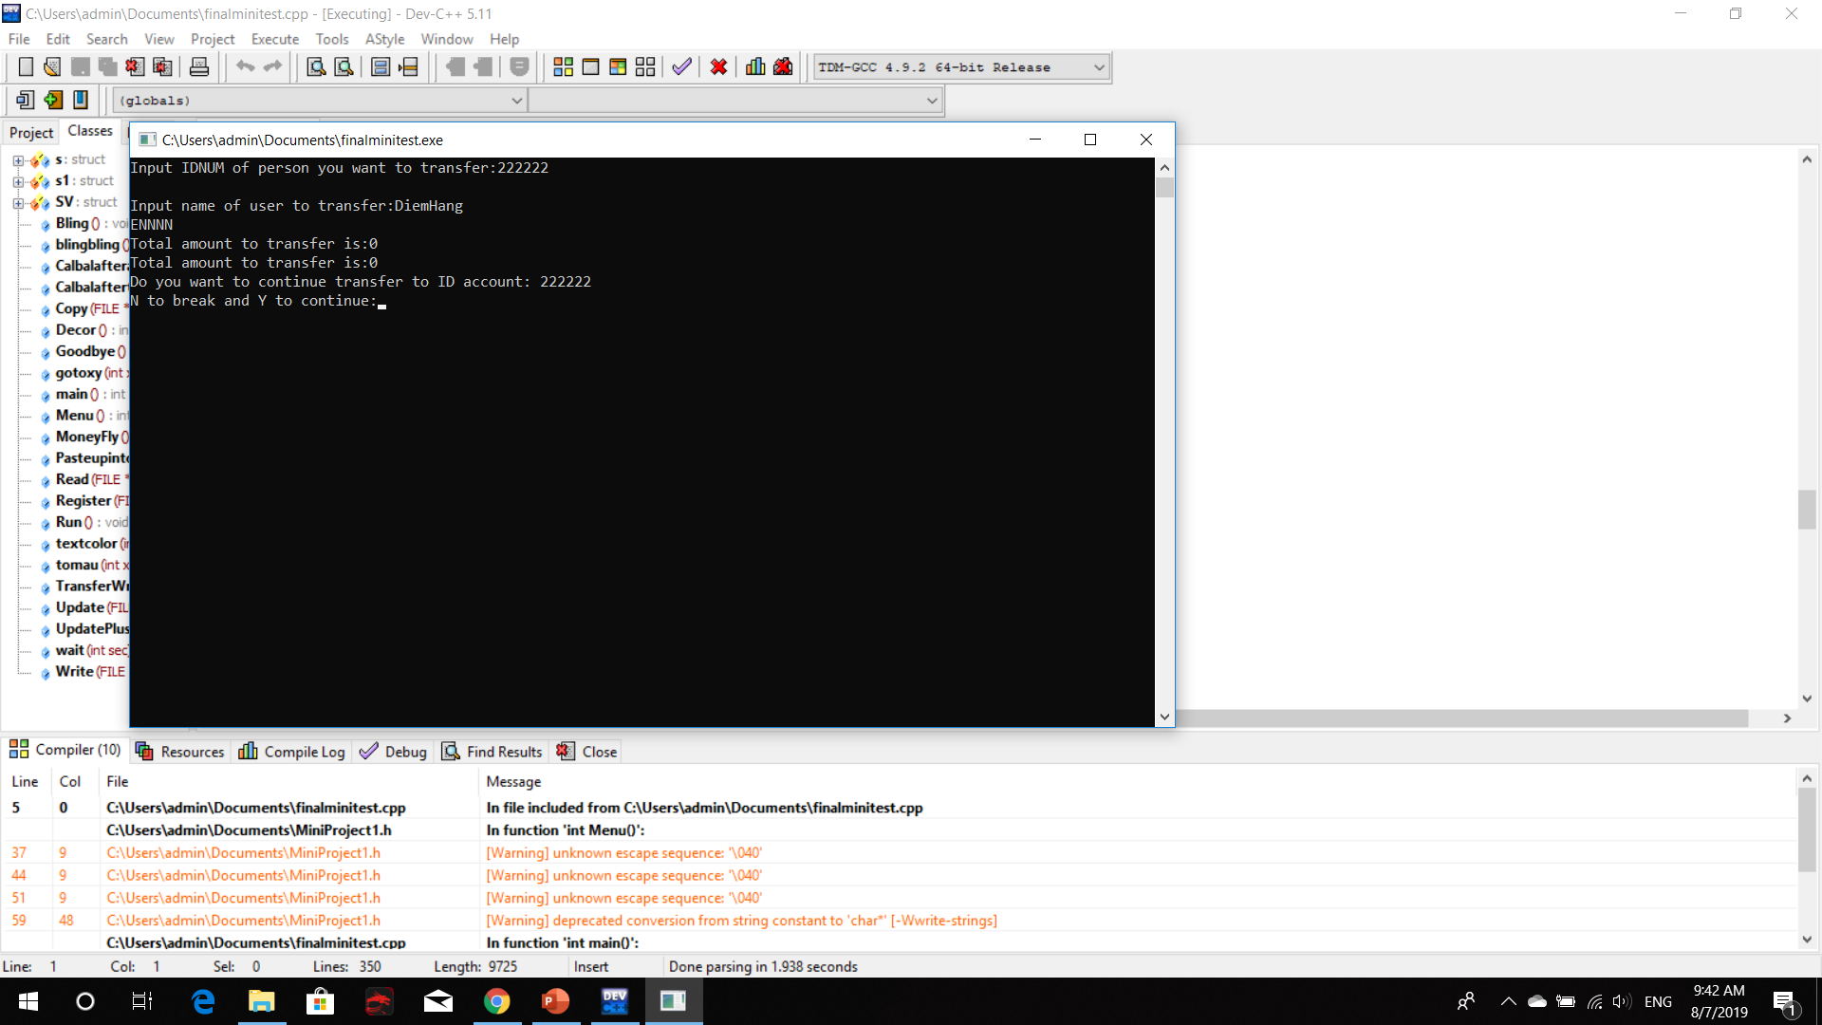
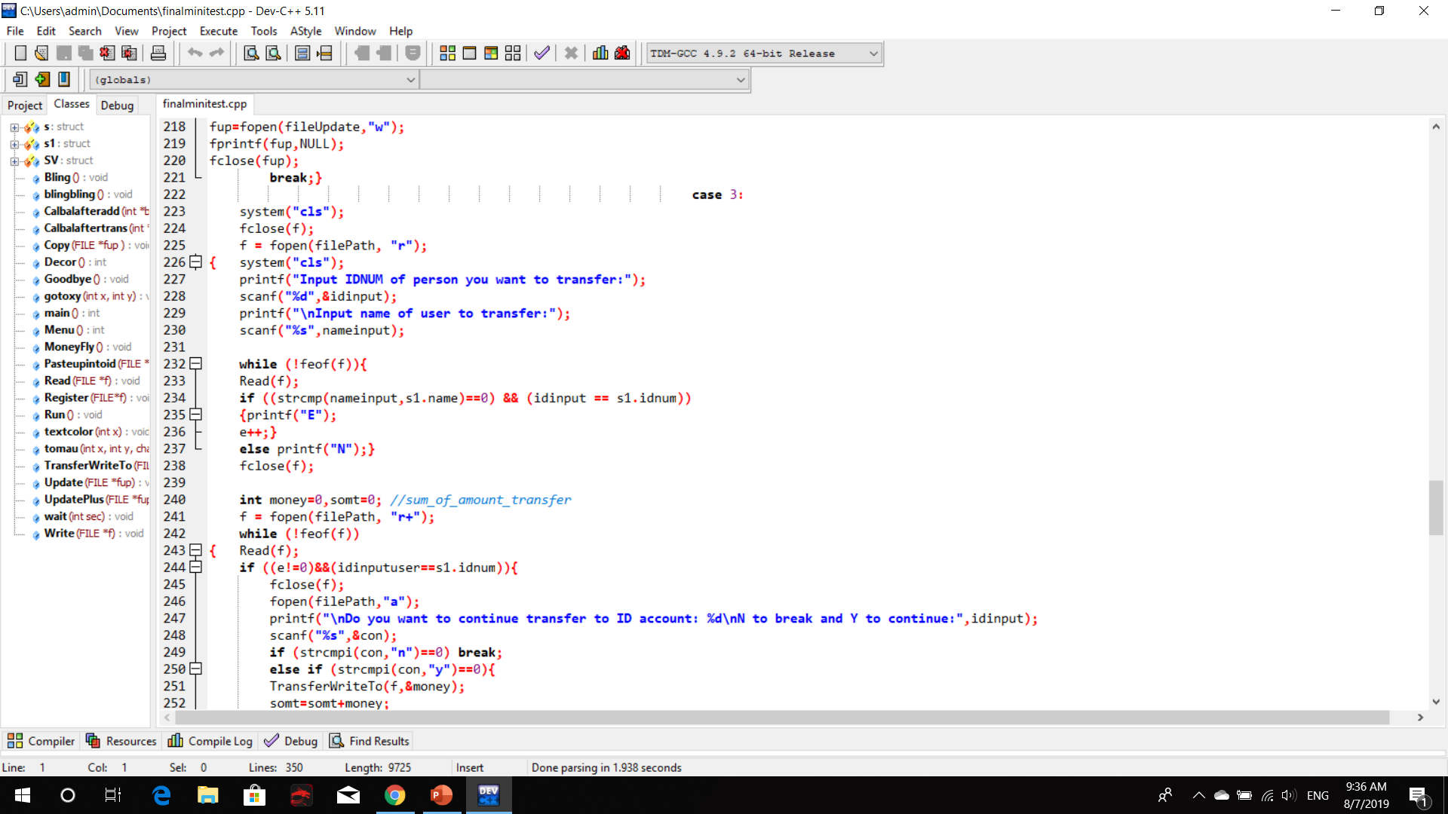
Input ID and name of person to transfer. Check exist or not.

Slide 25
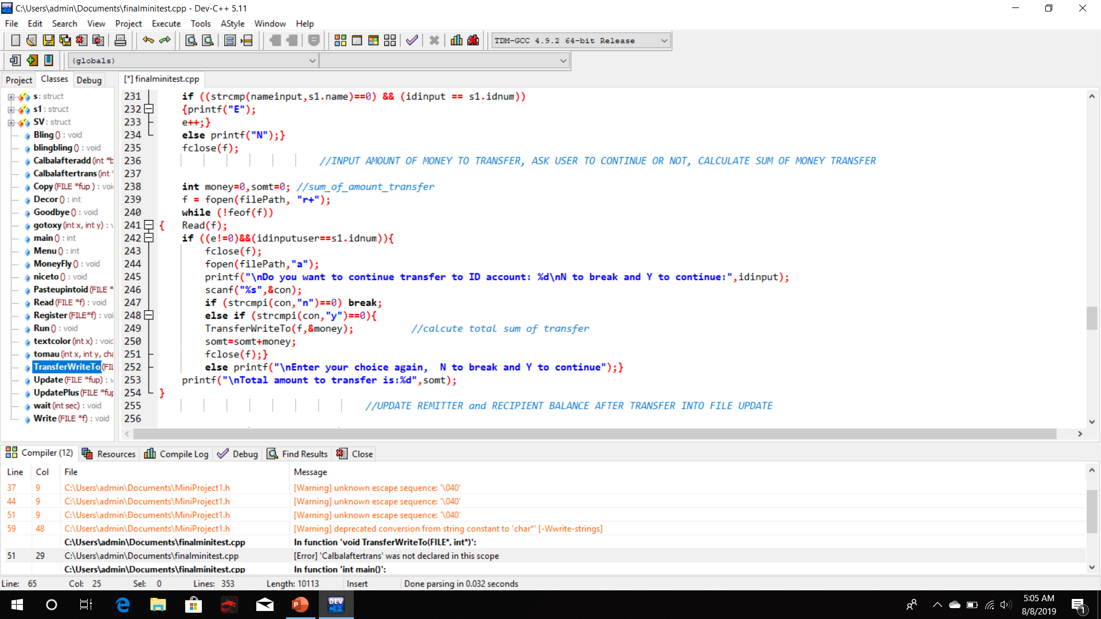
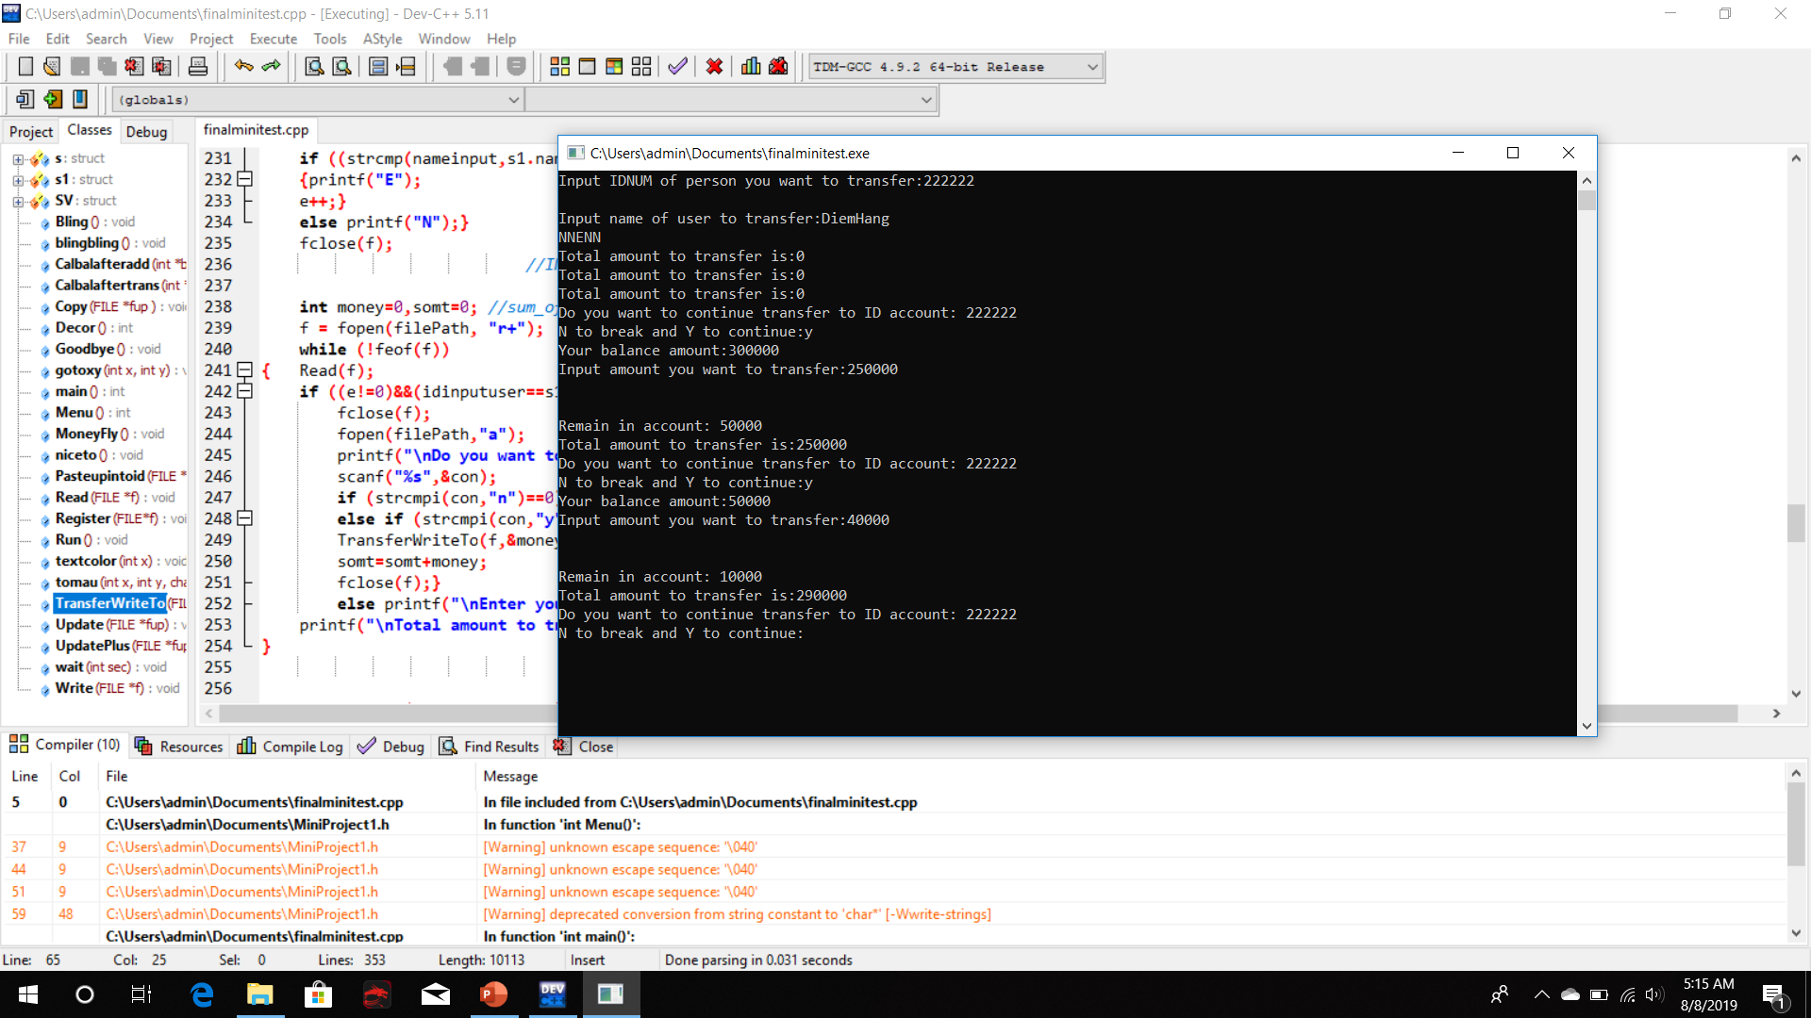
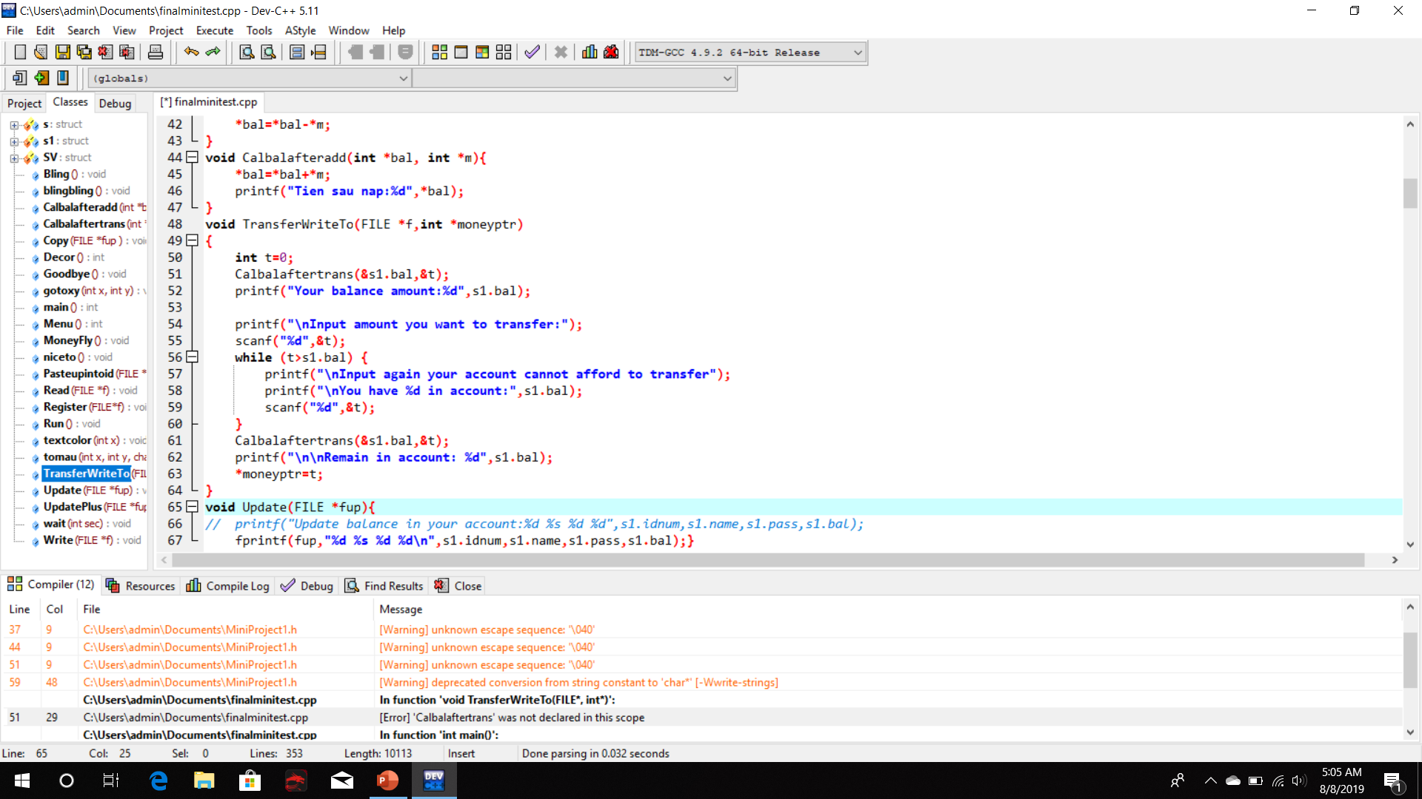
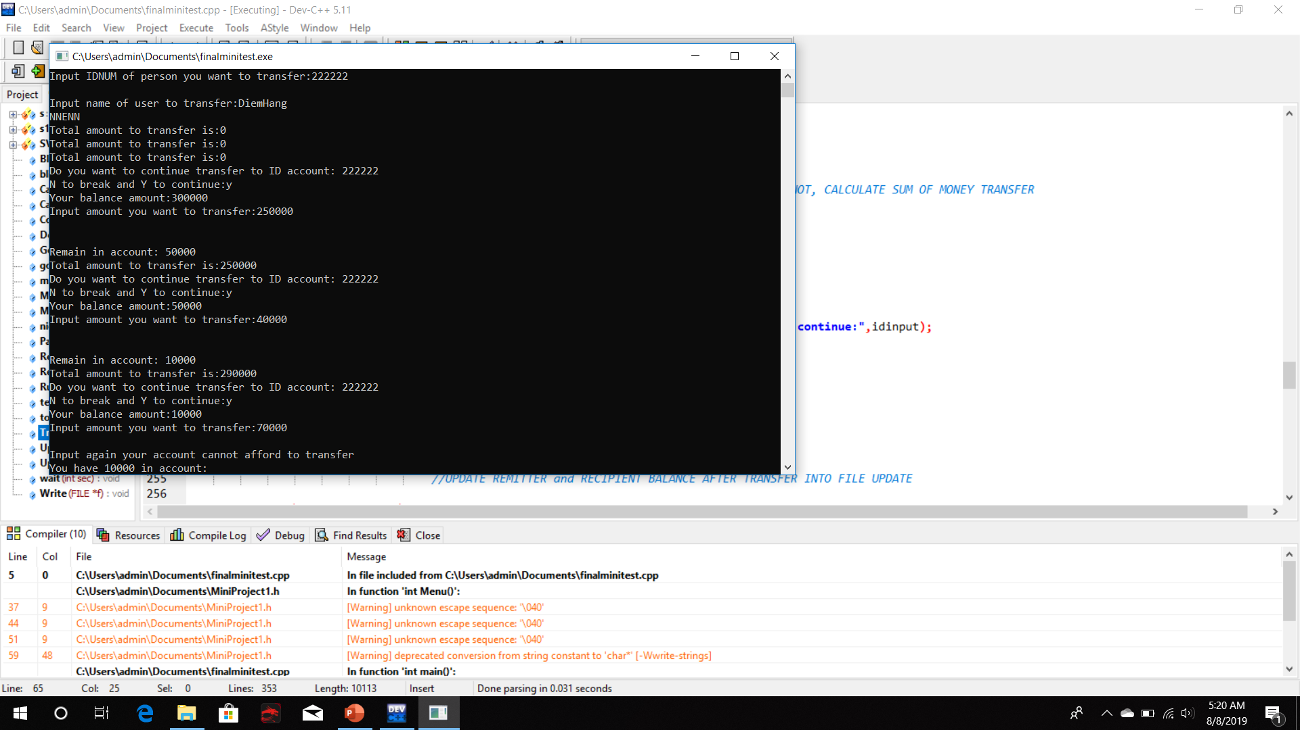
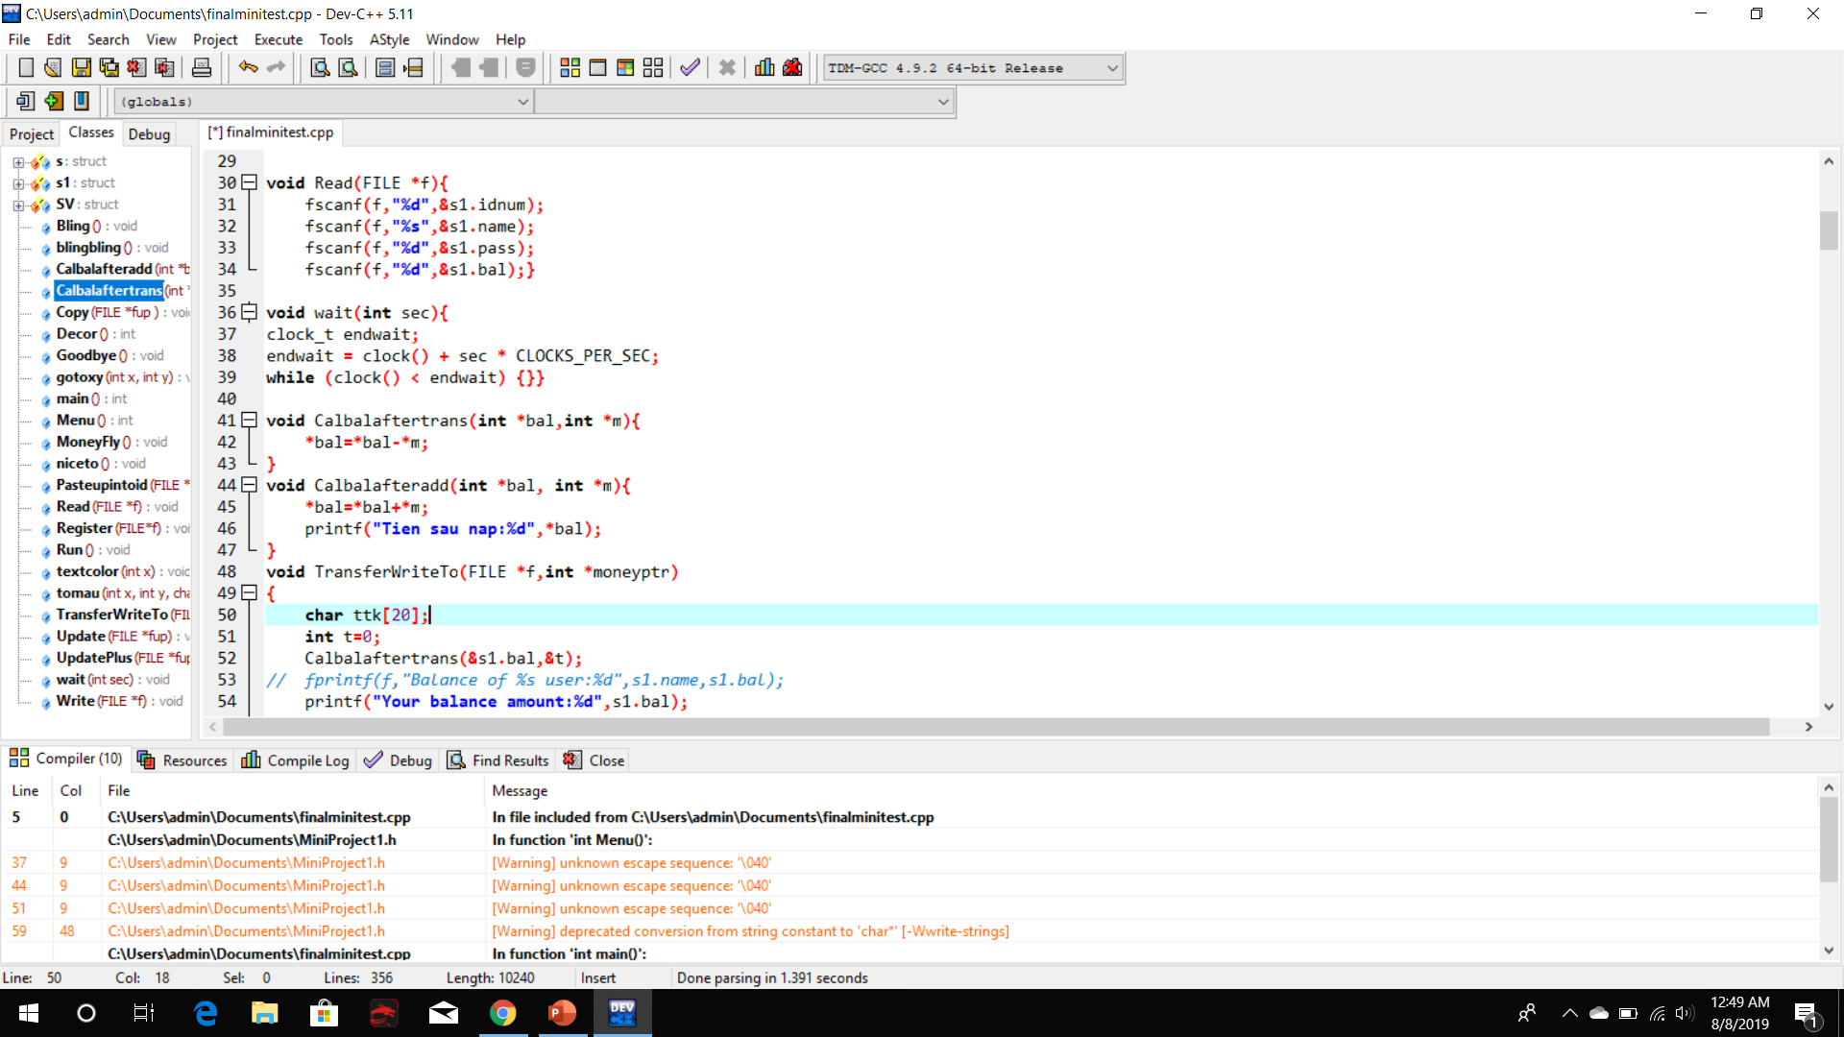
Input amount of money.
If larger than, smaller or equal current balance.

Slide 26
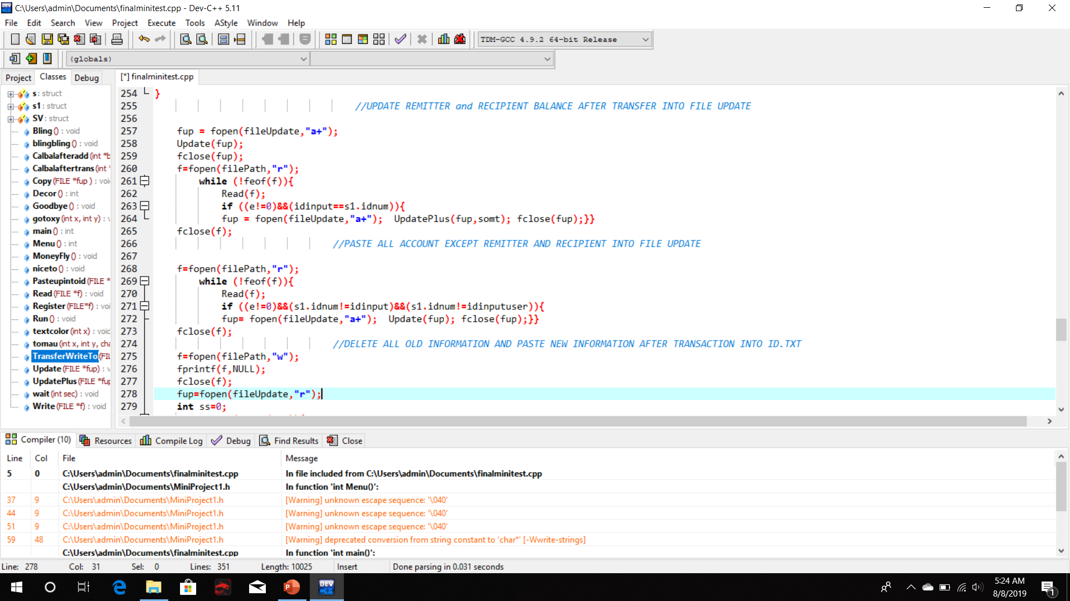
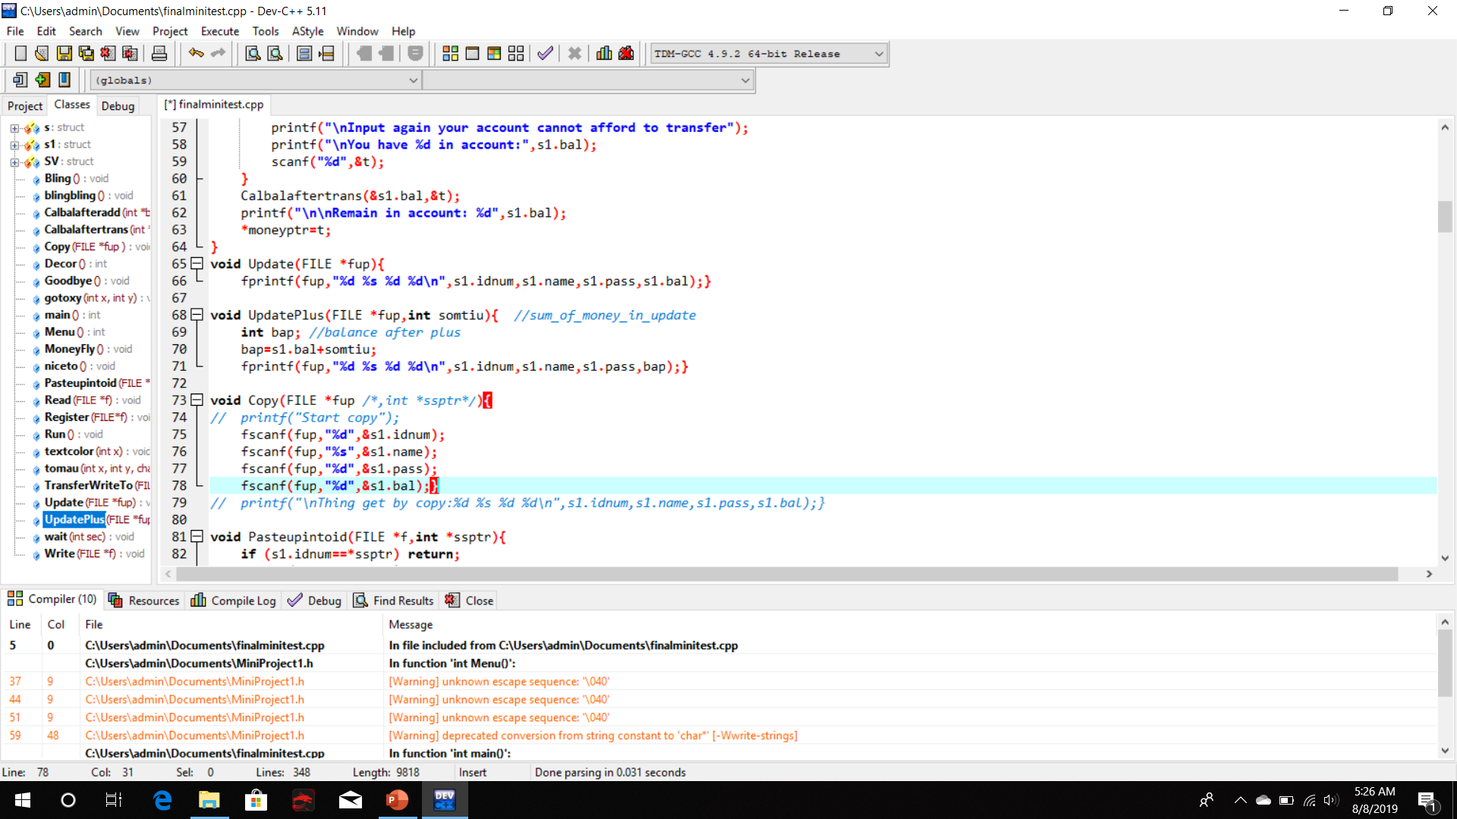
Upload new balance information
after transfer of both remitter and recipient.

Slide 27
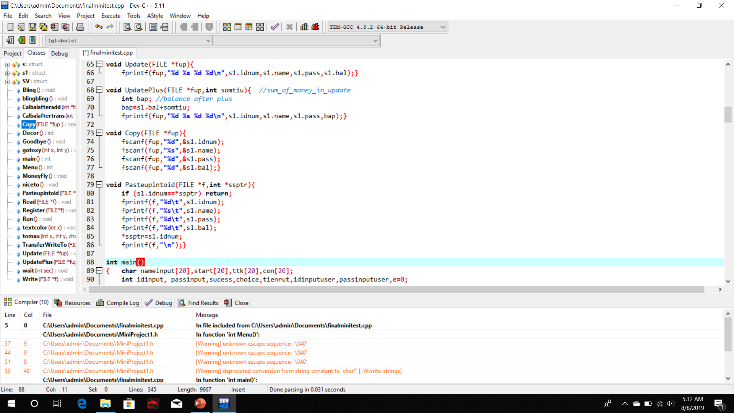
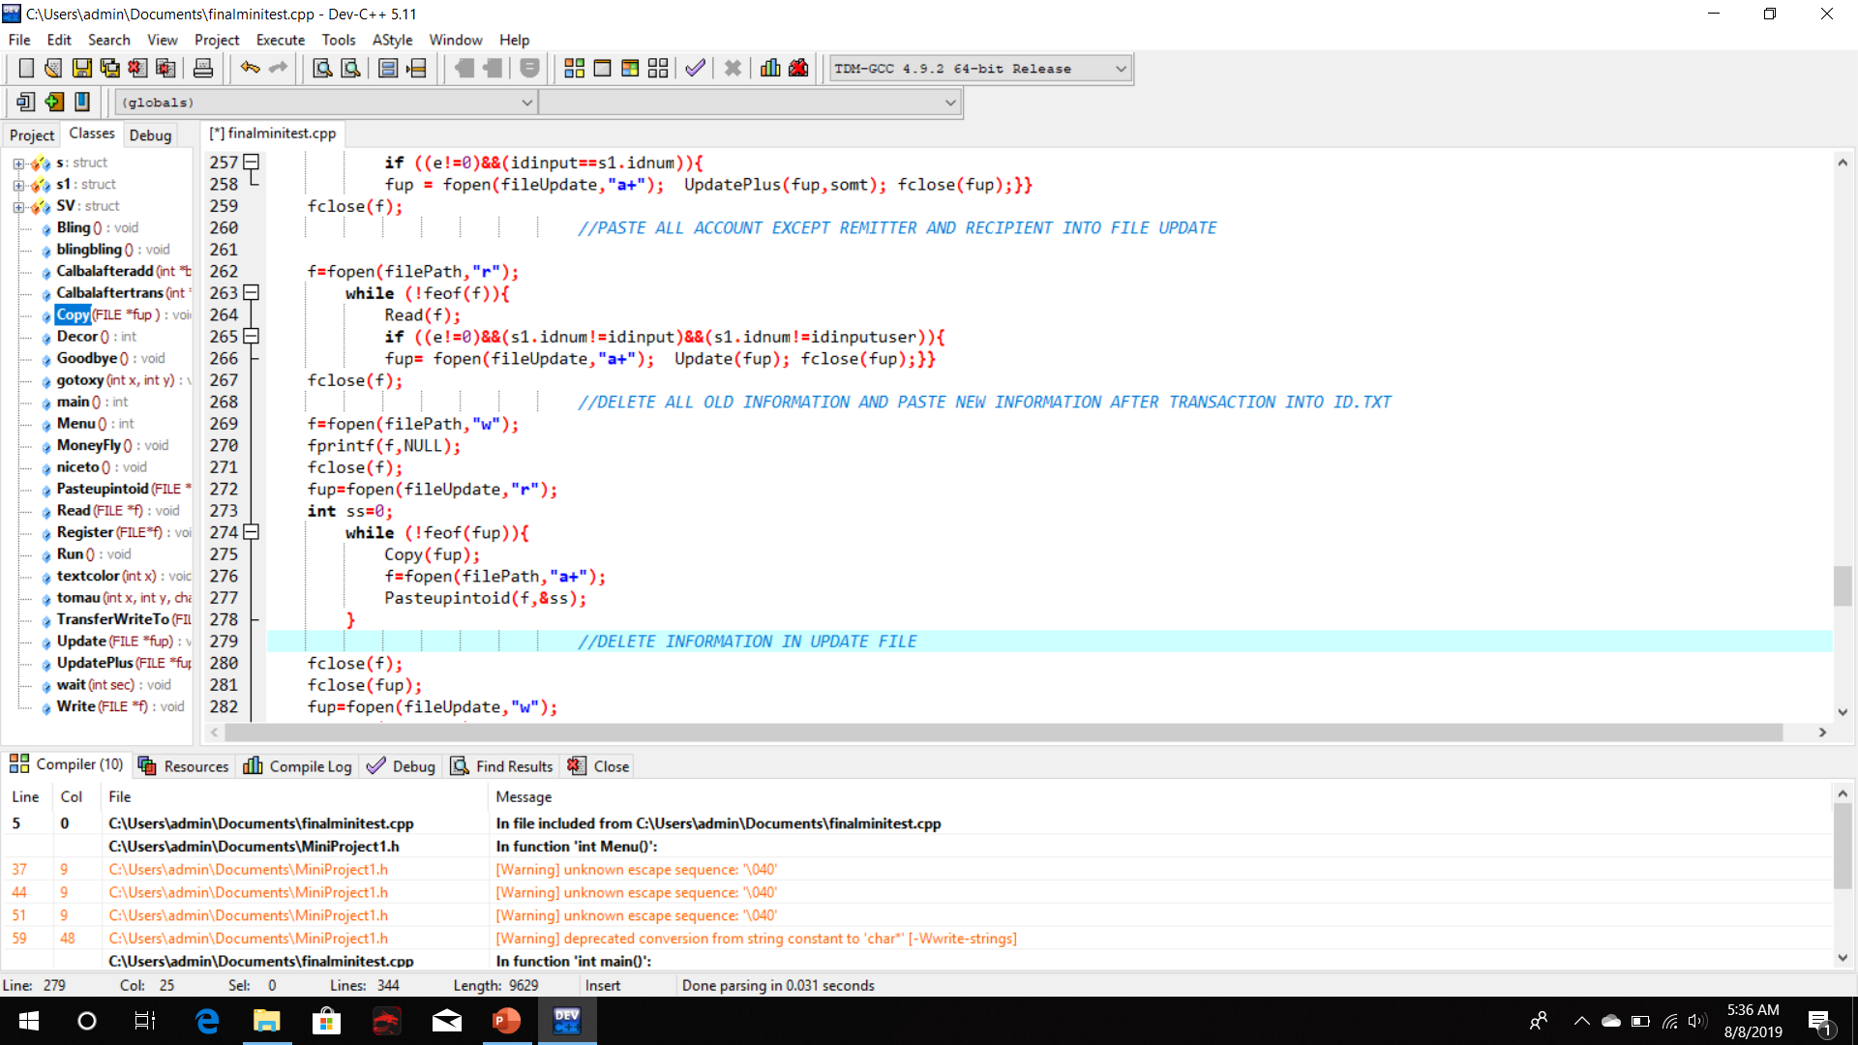
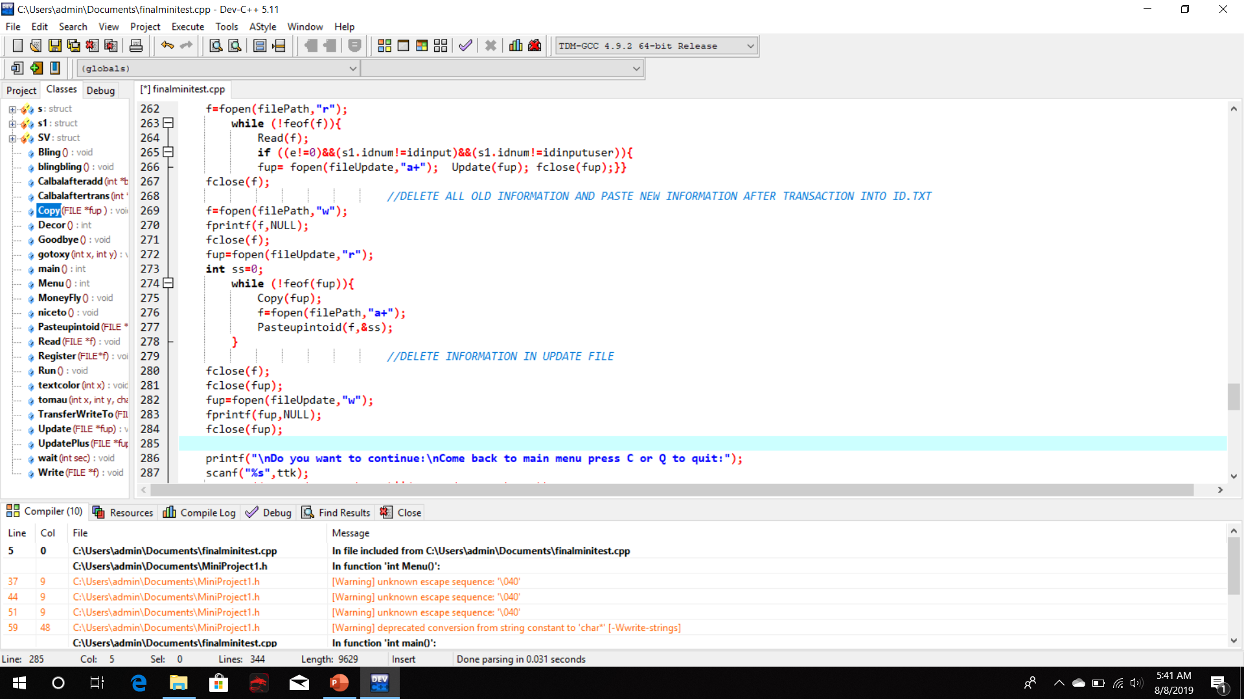
Paste new information in Update.txt
into ID.txt and clear Update.txt

Slide 28
WITHDRAW MONEY
5
Let move on to withdraw money case.

Slide 29
1. Print out information of customer: Name, ID Number, Balance.
2. Input amount of money that customer want to withdraw.
3. If larger or equal to current balance then continue. If not, make customer input again.
4. Update new balance to file.
5. Print out papers of money suiting the customer’s input.
6. Ask customer to come back to menu or not.
PSEUDOCODE

Slide 30
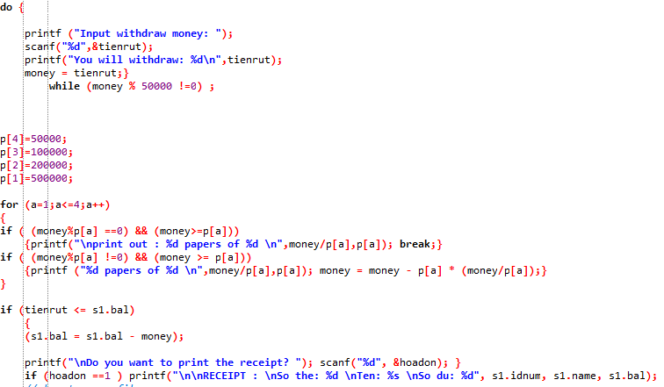

Slide 31
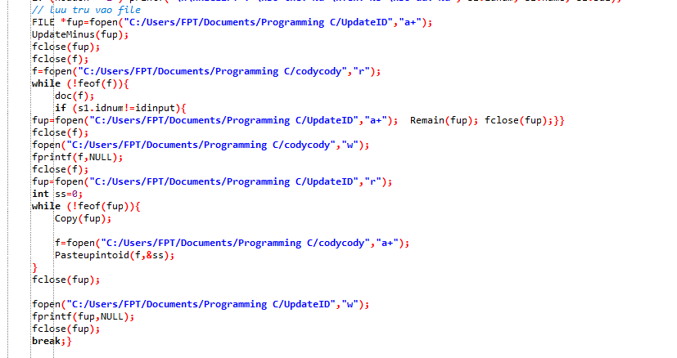

Slide 32
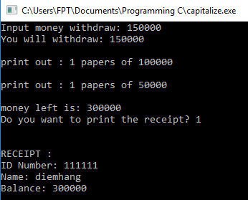

Slide 33
DEPOSITE MONEY
6
Let move on to deposite money case.

Slide 34
1. Get information
2. Update new information to update-file
3. Copy others information to update-file
4. Clear the main file
5. Scan information from update-file to main file
6. Delete all in the update-file
PSEUDOCODE

Slide 35
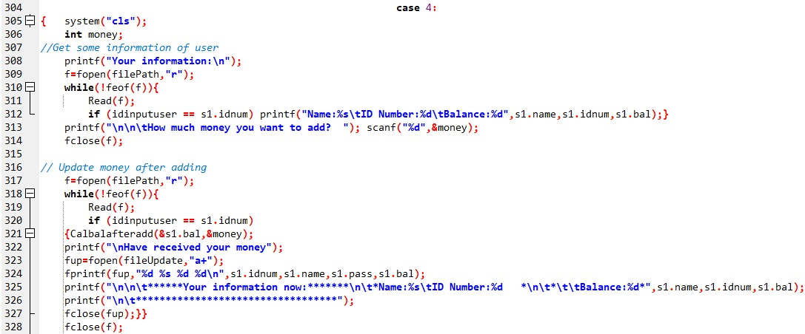
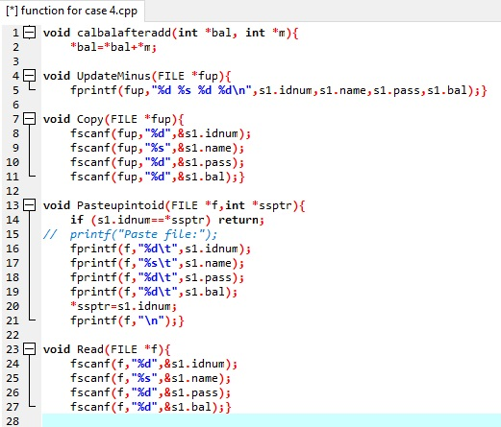
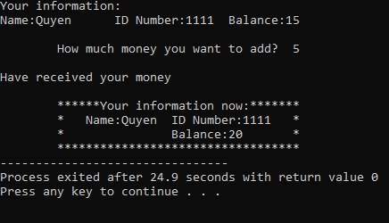
Get information Update new information to update-file

Slide 36
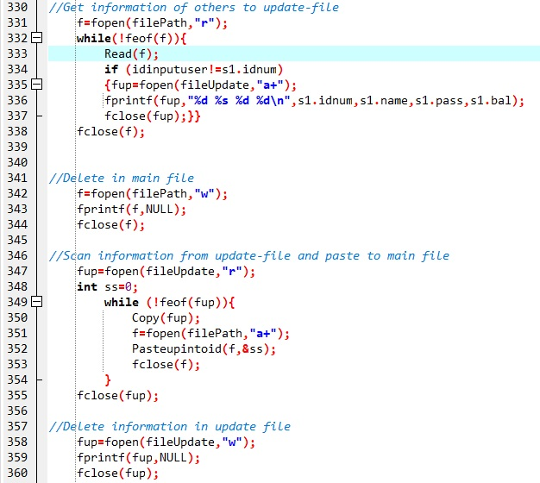
Copy others information to update-file
Clear the main file
Scan information from update-file to main file
Delete all in the update-file

Slide 37
TRANSACTION FILE
Built the function to write the transaction into transaction file after each transaction.

Slide 38
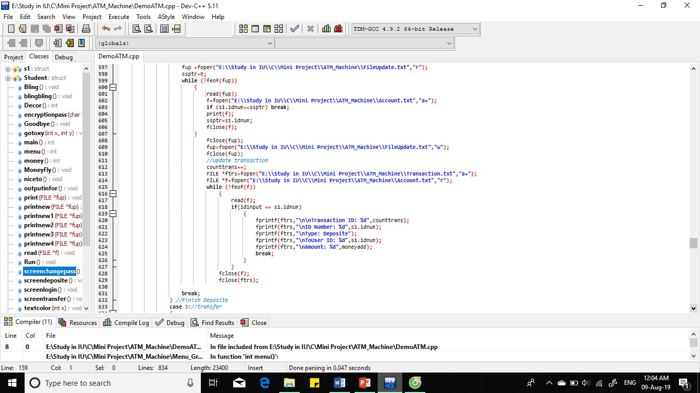
UPDATE TRANSACTION

Slide 39
Advances – Uncompleted – Develope
ADVANCES
Design
Count remaining times
Transfer pass
Encryption pass
Change pass
Using header file
UNCOMPLETED
List of amount of money bills remaining in the ATM machines.
Using function as much as possible.
DEVELOPE
Updated the remained money bills
Formating clearly and design more attractive.
Put the sound when using ATM.
Develop the function to lock the User account if login unsuccessful 3 times.

Slide 40
Thank you!
Any questions?

